Slide 1

Business Intelligence Using Tableau/Power BI – Day 2

Slide 2


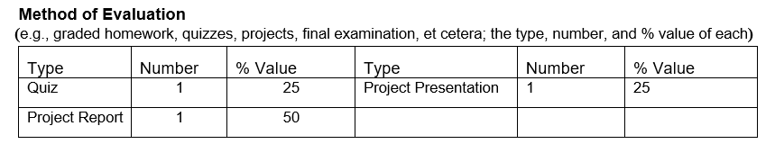
By : Hamid Rajaee

Slide 3
Navigation

Slide 4
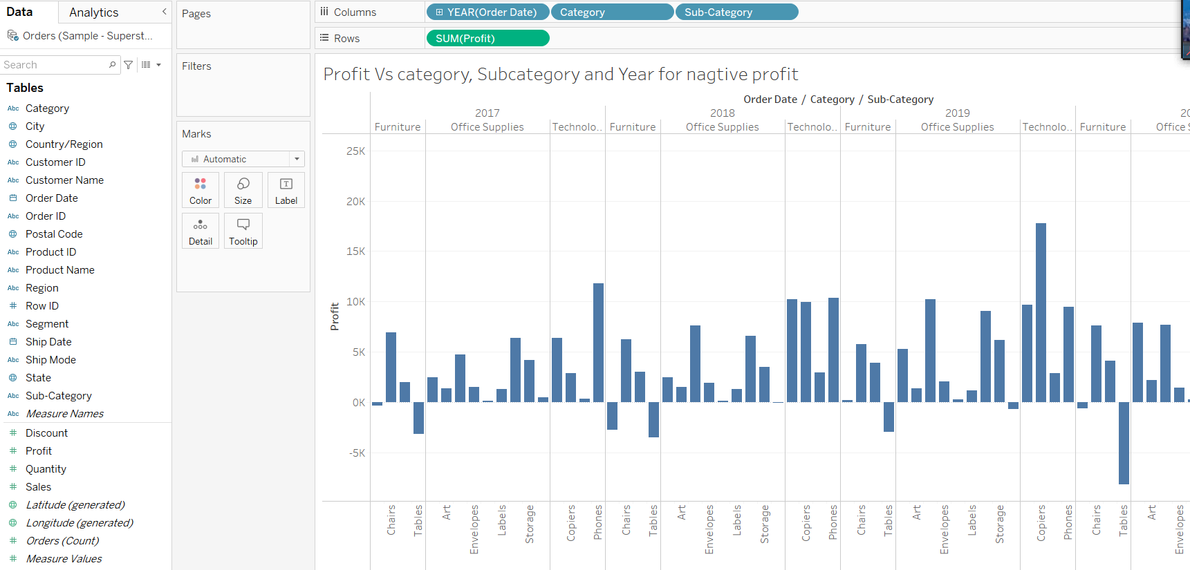
Filtering
In a new worksheet , First create the following graph

Slide 5
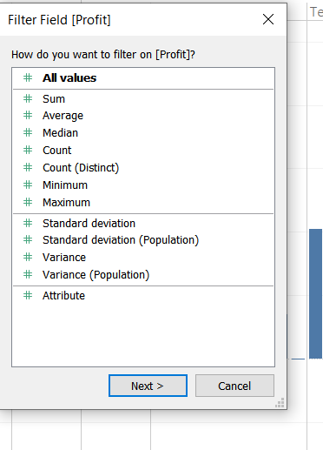
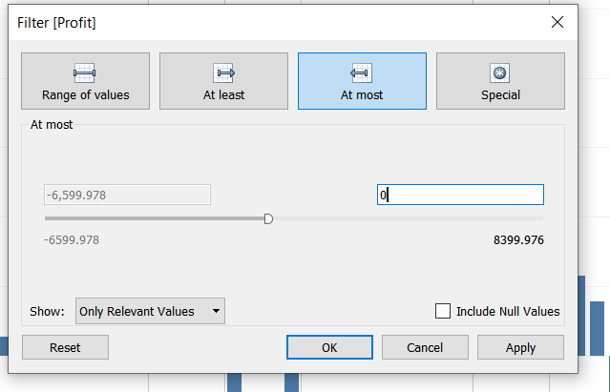
Then drag profit to filter then select sum , then Next, then select at most then change upper limit to 0 to just get negative profitable products

Slide 6
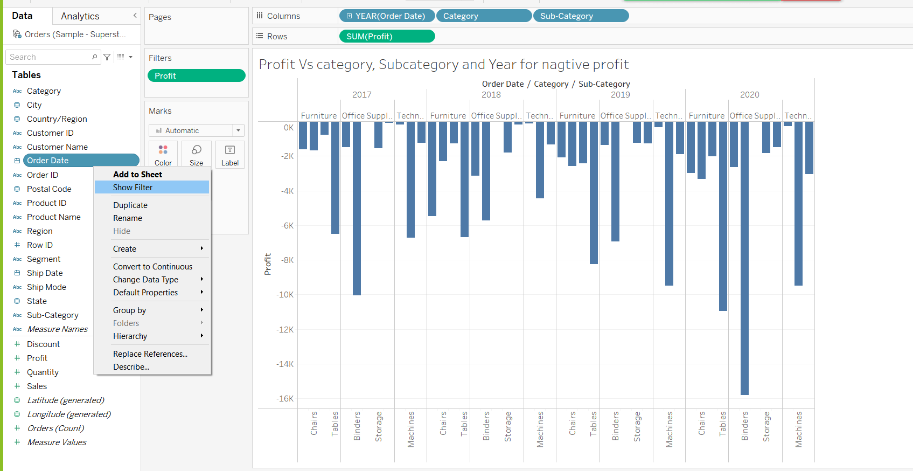
Then drag subcategory to label and Add year to show filter and brows that are they negative profitable in all years or not

Slide 7
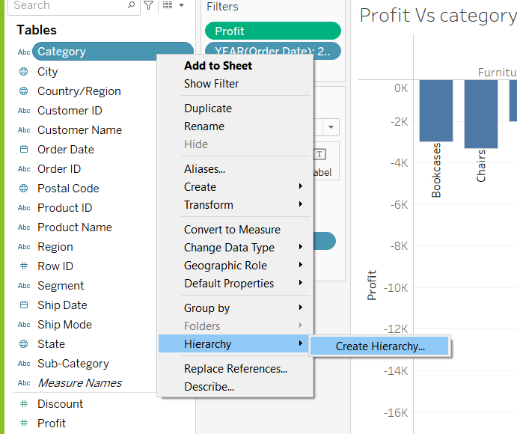
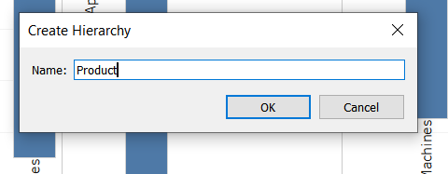
Creating hierarchy

Slide 8
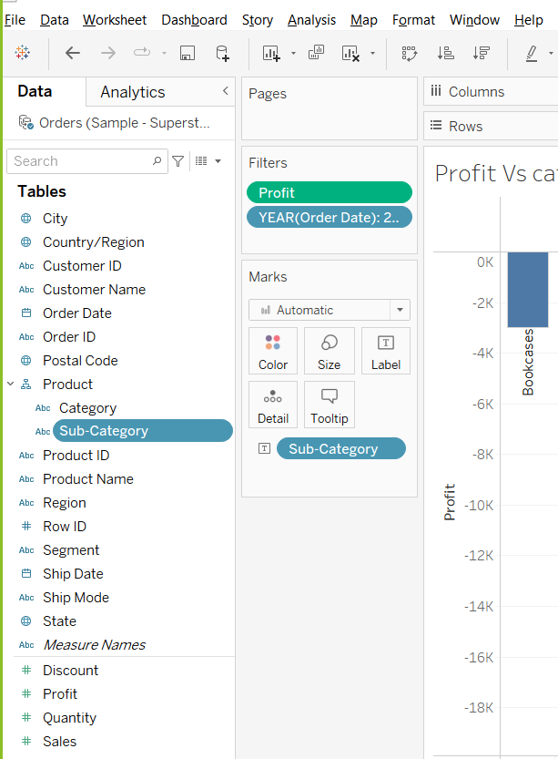
Then drag subcategory below category

Slide 9
Add filters to your view
T

Slide 10
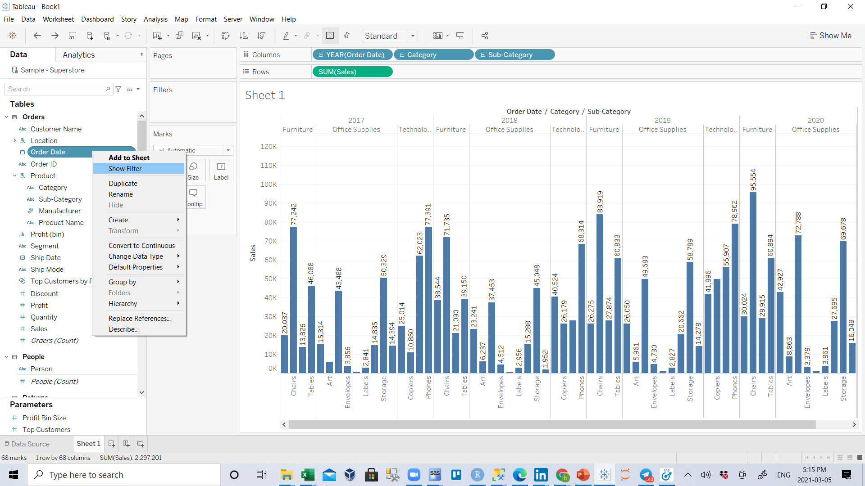
T
Delete sheet 2 and sheet 3 and clear sheet1
In new sheet
From the Data pane, drag Order Date to the Columns shelf.
From the Data pane, drag Sales to the Rows shelf.
From the Data pane, drag Category and Sub-Category to the Columns shelf and place it to the right of YEAR(Order Date).
.

Slide 11
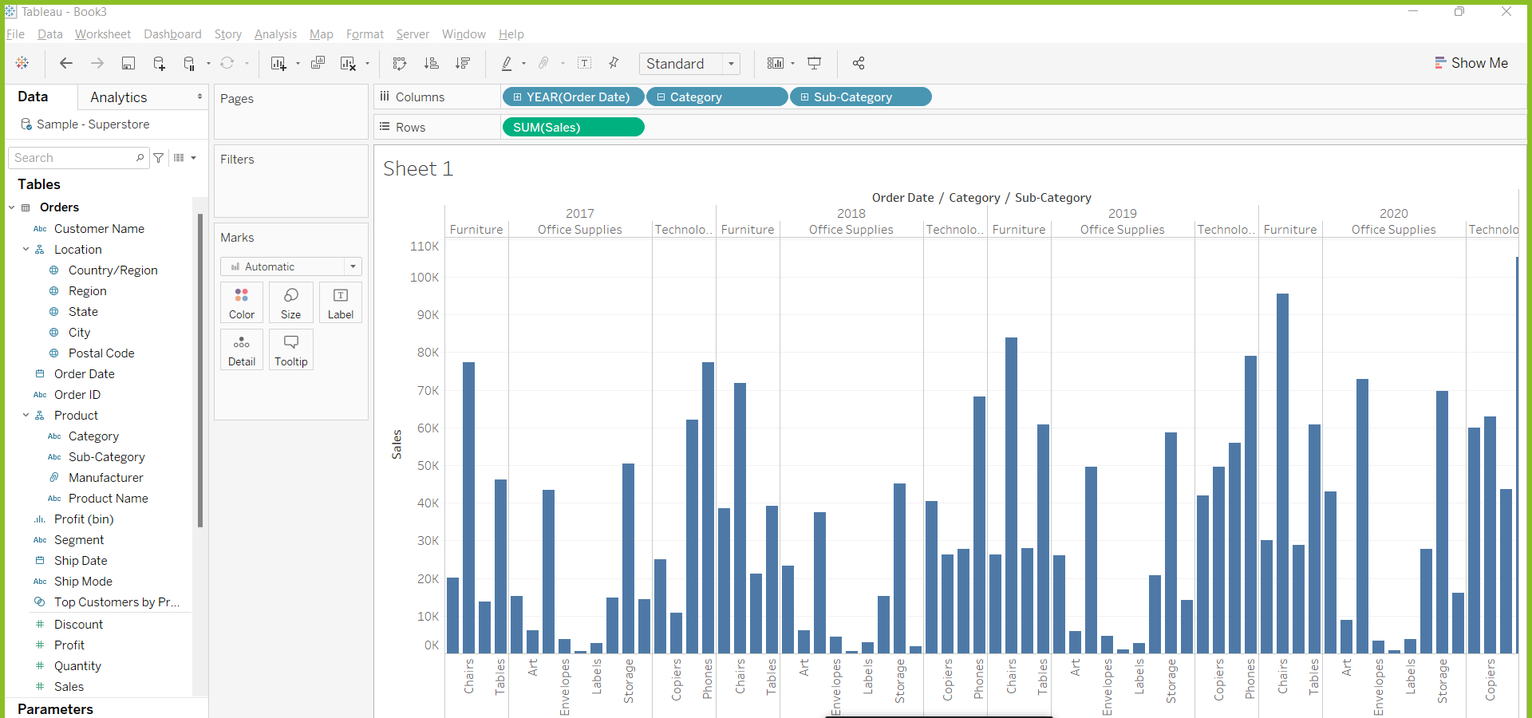

Slide 12
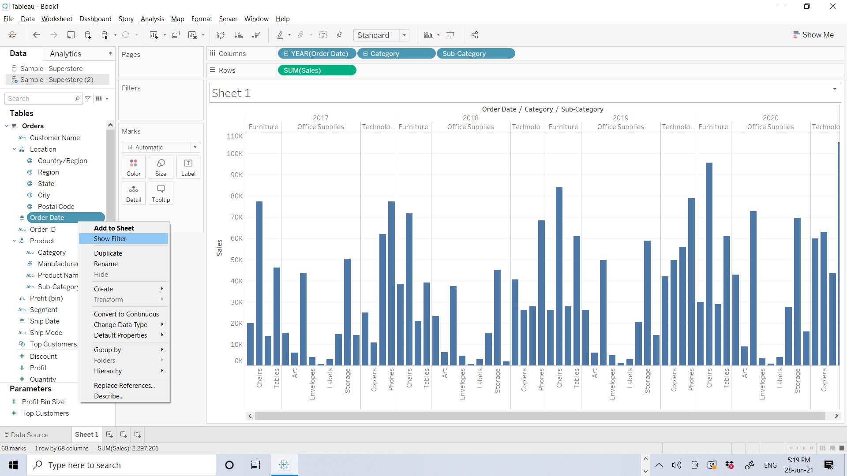
T
Add filters to your view
You can use filters to include or exclude values in your view. In this example, you decide to add two simple filters to your worksheet to make it easier to look at product sales by sub-category for a specific year.
In the Data pane, right-click Order Date and select Show Filter.
Repeat the step above for the Sub-Category field

Slide 13
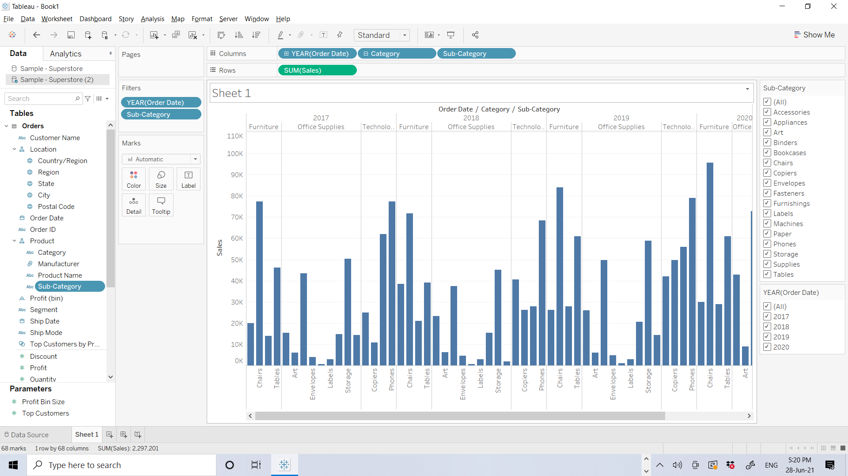

Slide 14
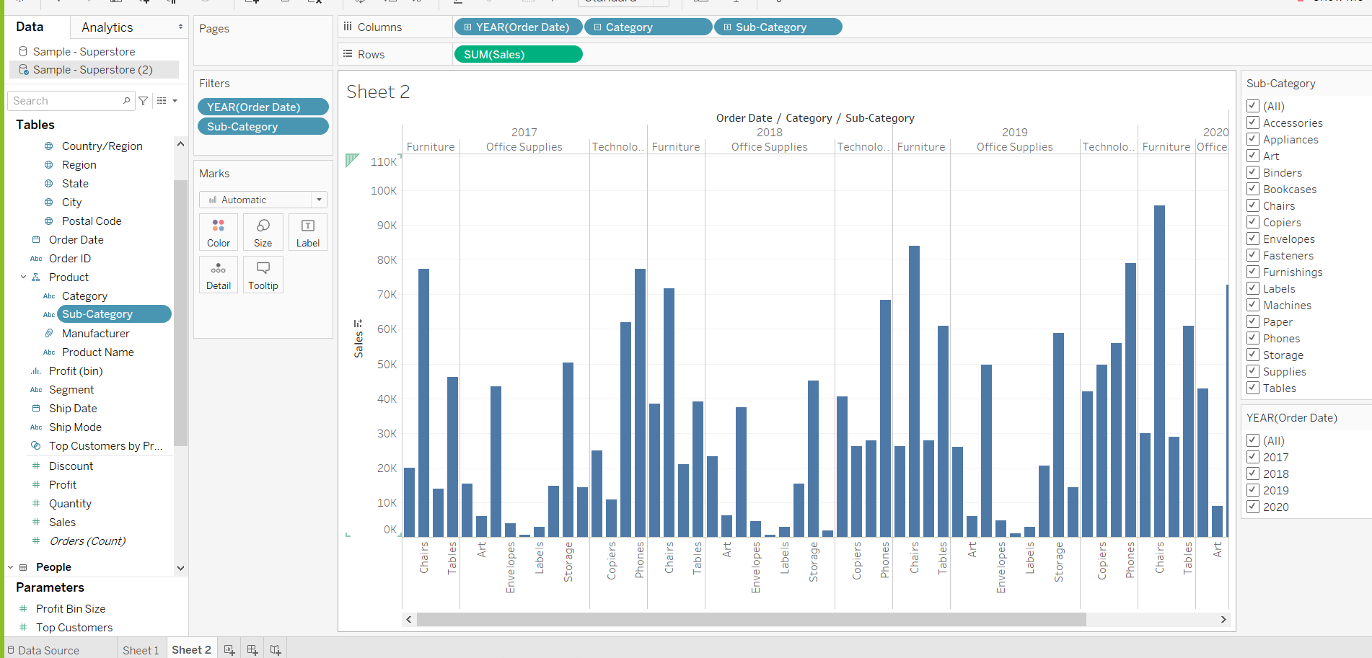
The filters are added to the right-hand side of your view in the order that you selected them. Filters are card types and can be moved around on the canvas by left clicking on the filter name and dragging it to another location in the view. As you drag the filter, a dark black line appears, showing you where you can drop the filter to move it.

Slide 15
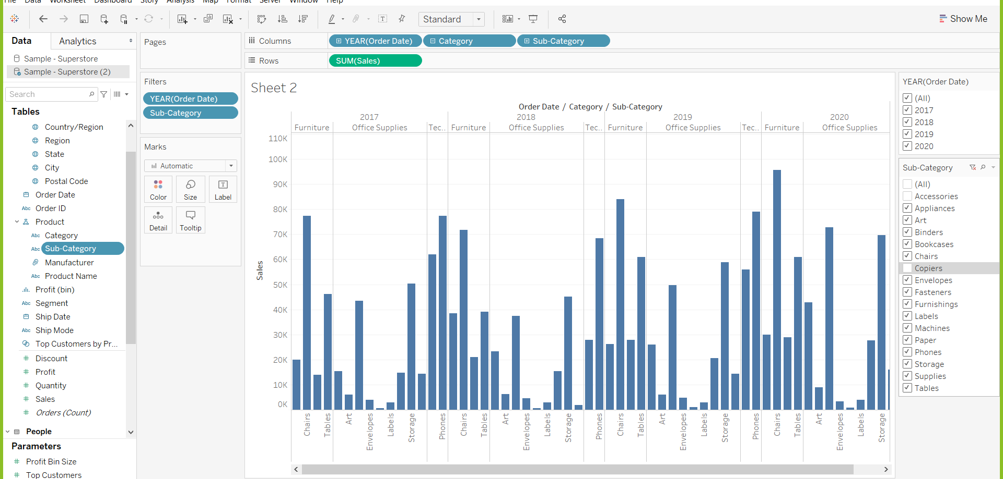
You can select or unselect(uncheck) any field in filter to change the graph

Slide 16
Add color to your view
T

Slide 17
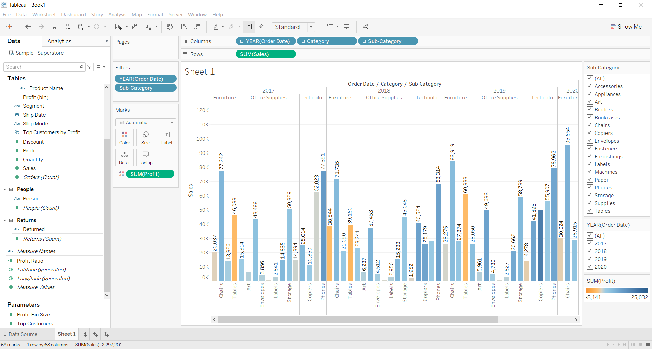
T
Adding filters definitely helps you to sort through all of this data—but that’s a lot of blue! Time to do something about that.
Currently, you are looking at sales totals for your various products. You can definitely see that some products have consistently low sales, and might be good candidates for reducing sales efforts for those product lines, but what does overall profitability look like for your different products? You decide to drag Profit to color to see what happens.
From the Data pane, drag Profit to Color on the Marks card.
By dragging profit to color you now see that you have negative profit in Tables, Bookcases, and even Machines. Another insight is revealed!
Note: Tableau automatically added a color legend and assigned a diverging color palette because your data includes both negative and positive values

Slide 18
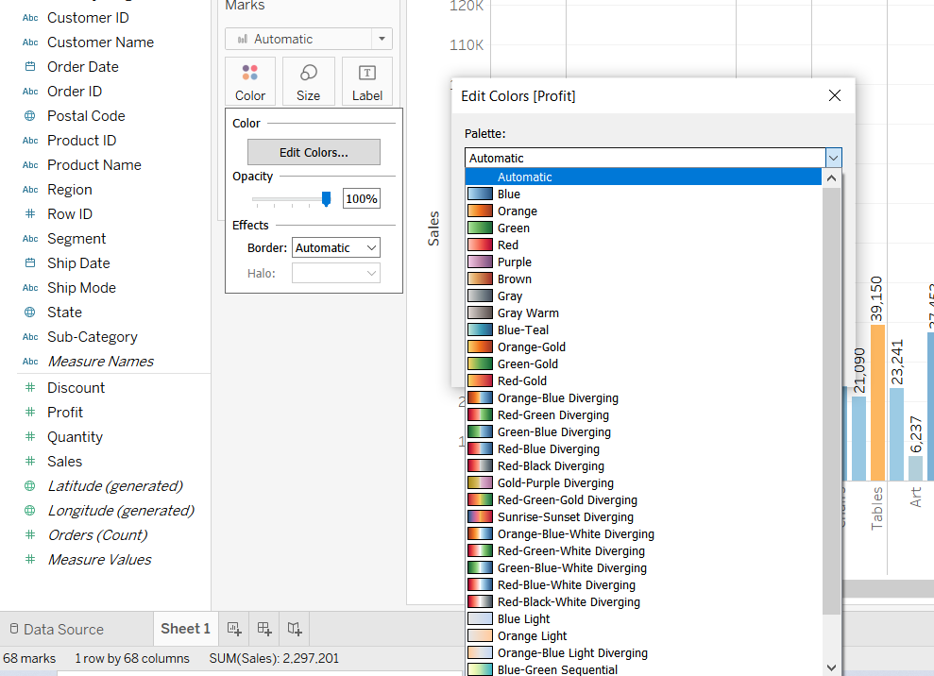
T
Adding color visually enhances your view, but it can also make interesting data pop. Tableau uses a default color palette to assign colors to the products in your view, but you are not limited to that color palette. You have choices!
If you want to use different colors than the ones shown, you can change the colors or color palette at any time. Simply click Color on the Marks card, and then click Edit Colors. You can select a different color palette in the Edit Colors dialog box that opens.
Depending on the data in your view, the Edit Colors dialog box might show you a diverging color palette versus a categorical color palette.
Diverging color palettes look like the image on the right. Diverging color palettes are generally assigned to continuous fields.
1
3
2

Slide 19
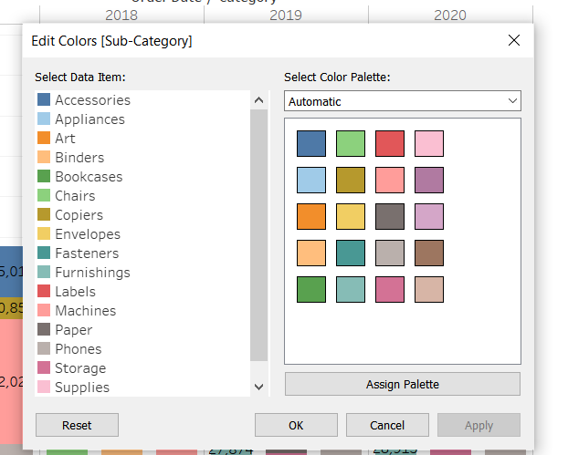
T
Categorical color palettes like this one are generally assigned to discrete fields.

Slide 20
Change Titles and Format

Slide 21
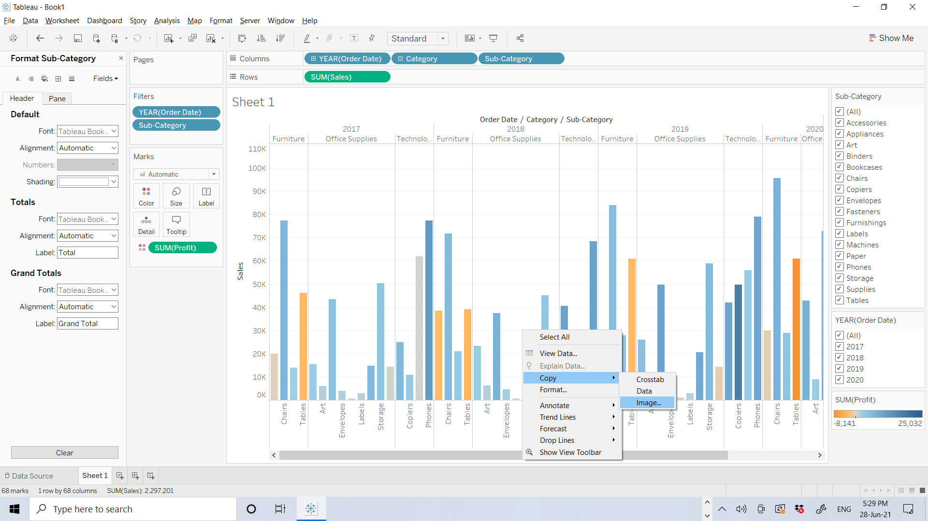
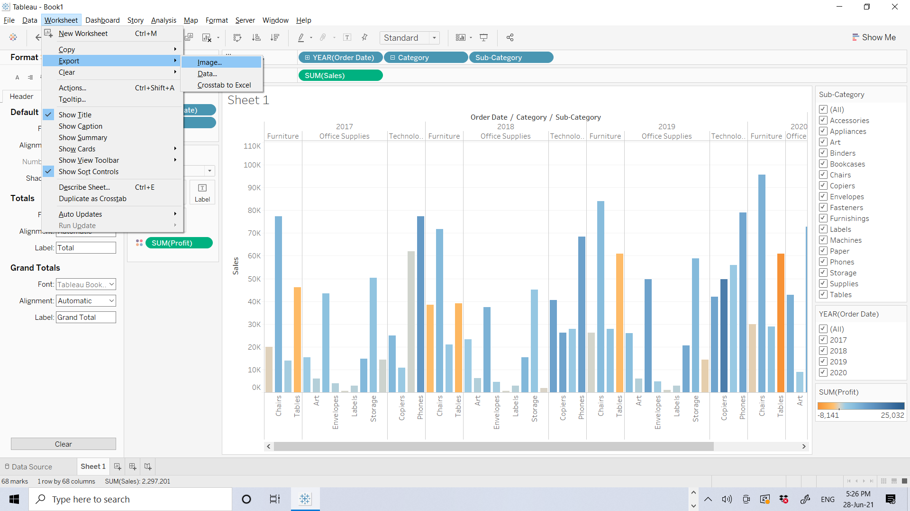
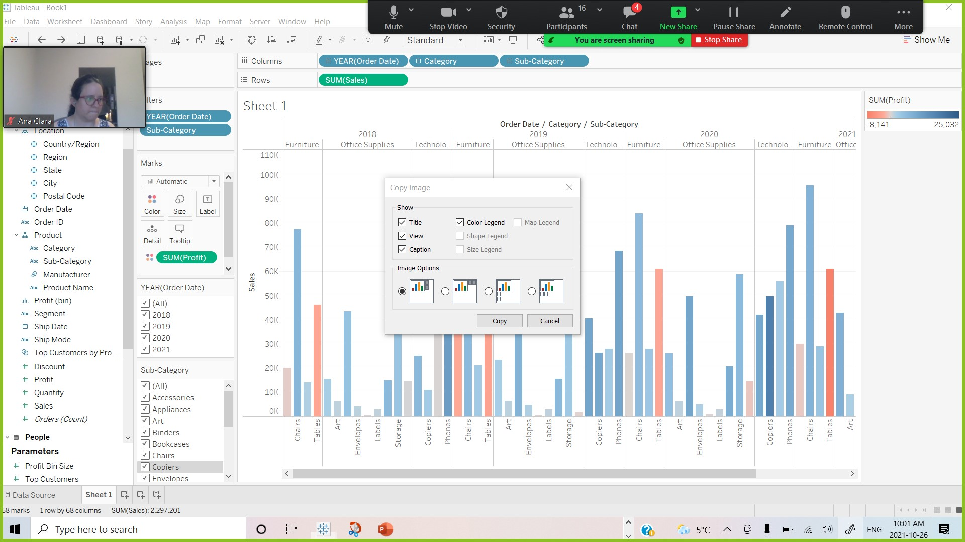
Export Image for PowerPoints or word file or
Method #1: Getting screen shot
Method #2: from Worksheet tab choose Export ➔Image➔ check or uncheck what ever you want …(it is not available in tableau public)
Method #3: R.C on Charts and select Copy➔ Image➔ check or uncheck what ever you want ➔copy and paste on PowerPoints or word file or …

Slide 22
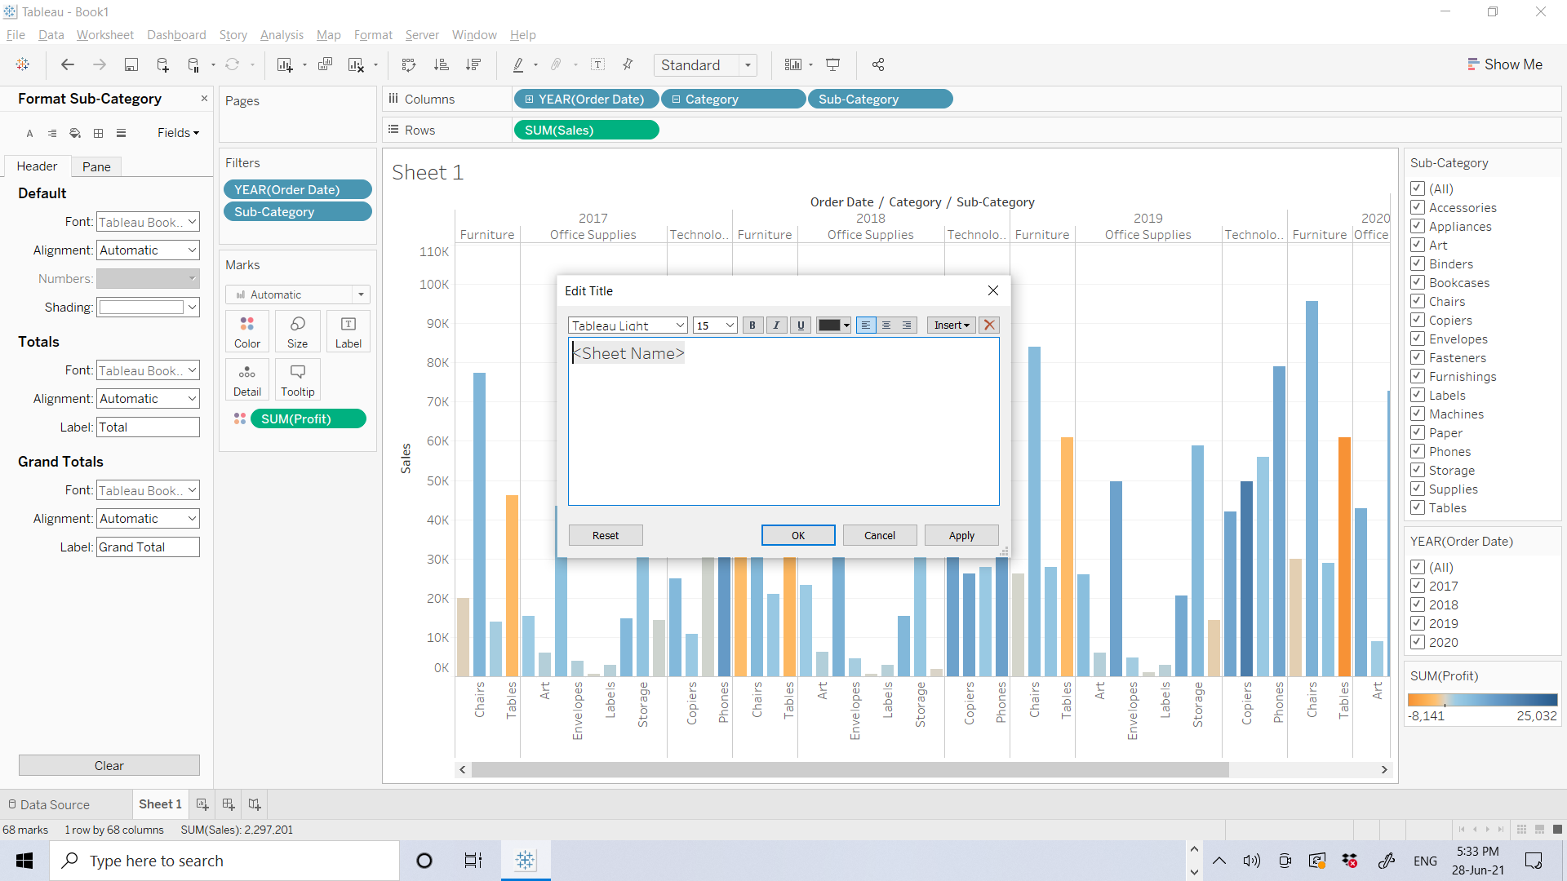
If you double click on Title, you can change font, size , …

Slide 23
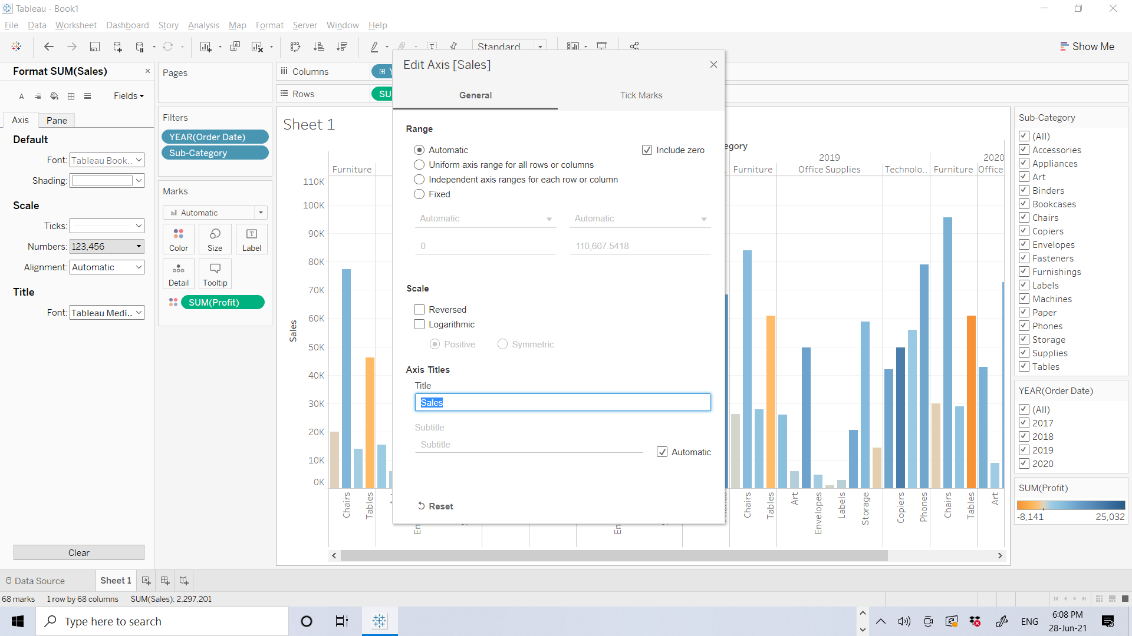
If you double click on Axis Titles, you can change it .

Slide 24
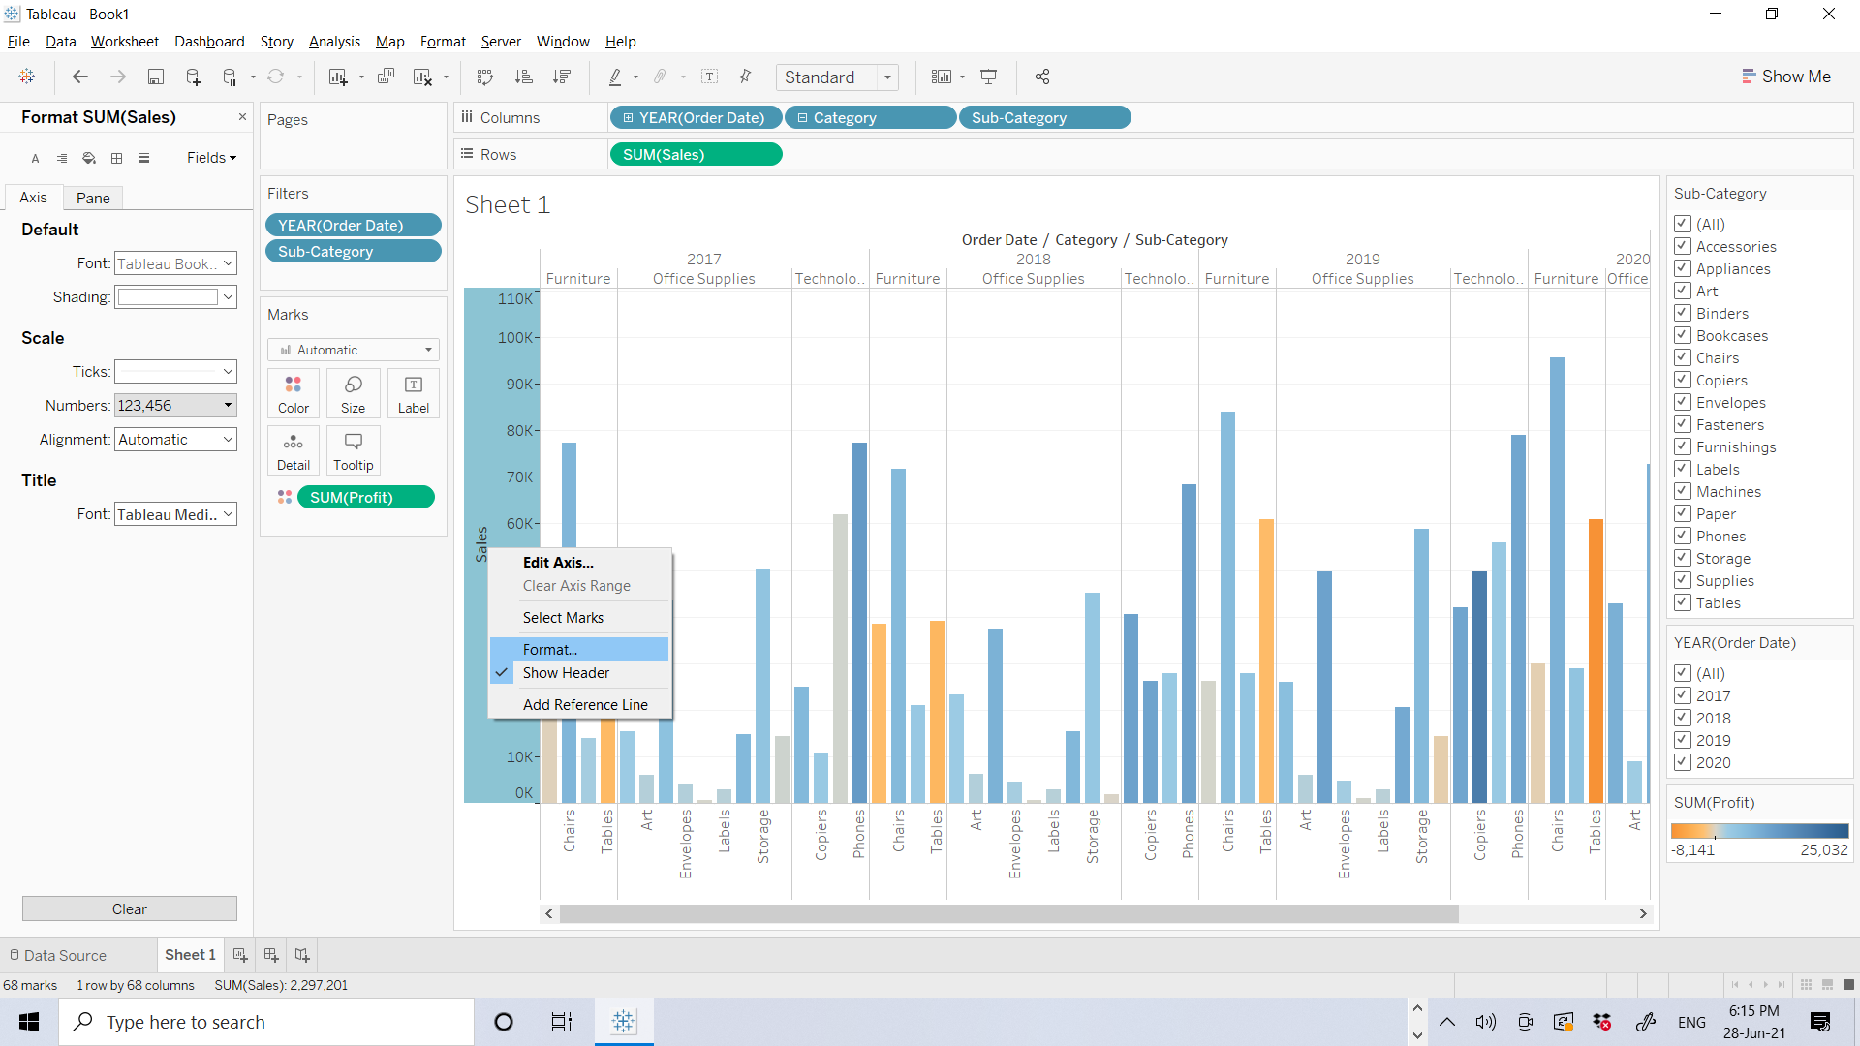
For changing size and font of axis NUMBERS R.C. on it and select Format ….

Slide 25
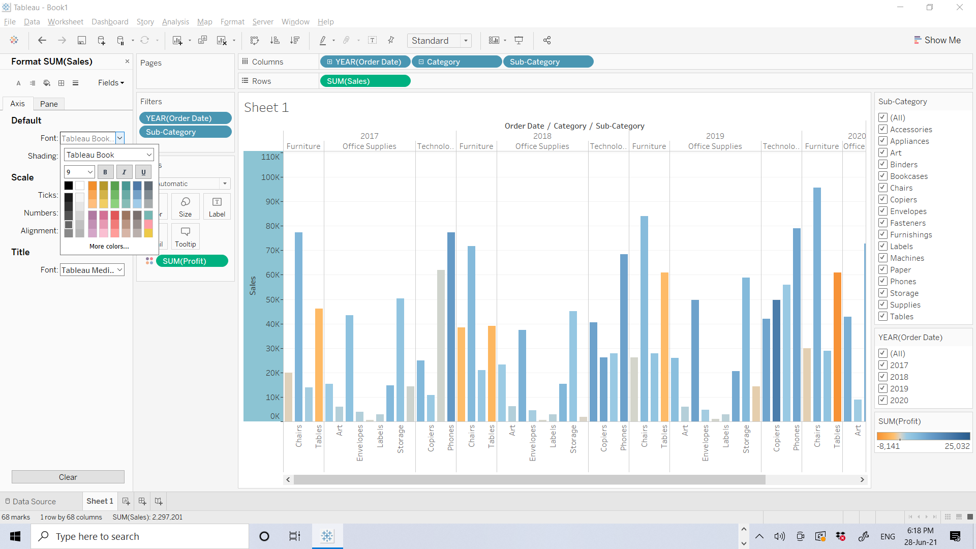
For changing size and font of axis NUMBERS R.C. on it and select Format then
In Format window on Axis tab , you can change Font, Size, Bold, color,… of title and then you can close format window.

Slide 26
Find key insights
T
Looking at your view, you saw that you definitely had some unprofitable products, but now you want to see if these products have been unprofitable year over year.(later we want to check if these products have been unprofitable for all states or just for some of them to figure out should we discontinue sailing these products all over the US or just in some states)
Time to use your filters to take a closer look
Note: for this course, I just focus on the south, but in real work, you should better find profit for each product in each city and recommend to stop selling negative profitable product based on each city

Slide 27
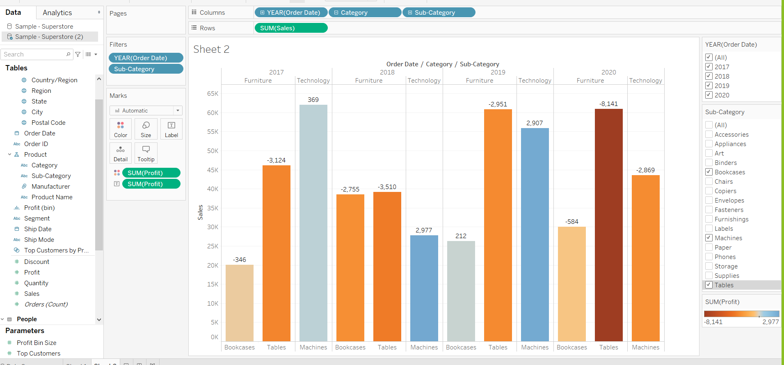
For continue this project delete sheet 2 and continue with sheet 1
You can drag and drop profit to Label in Marks card and select Bookcases, Machines and Tables , because we can see we have negative profit for them . We should continue our investigation to figure out this negative profit happened in all regions and all states or not.
Please undo this step to follow following slides

Slide 28
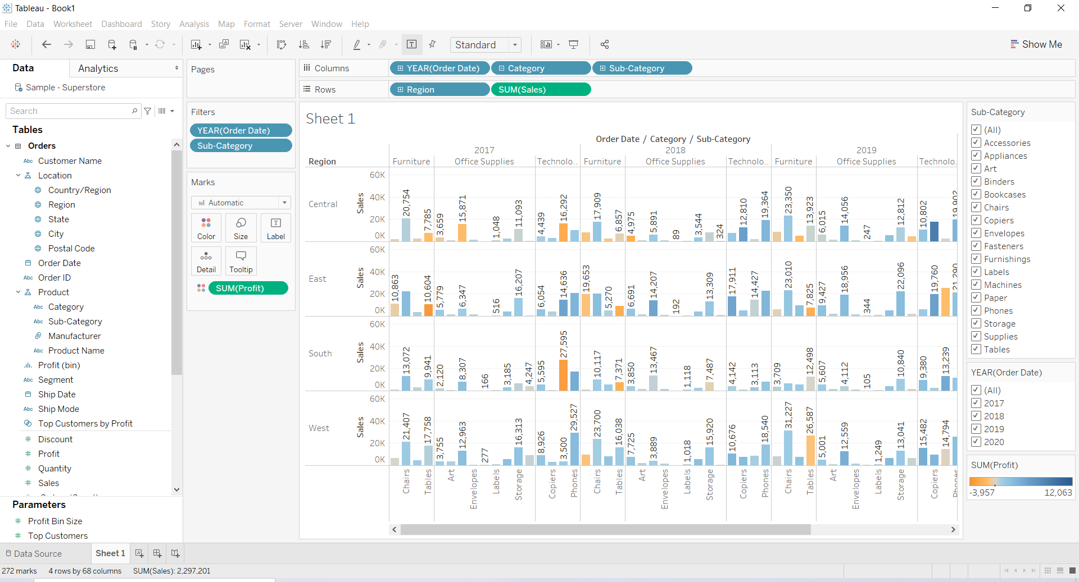
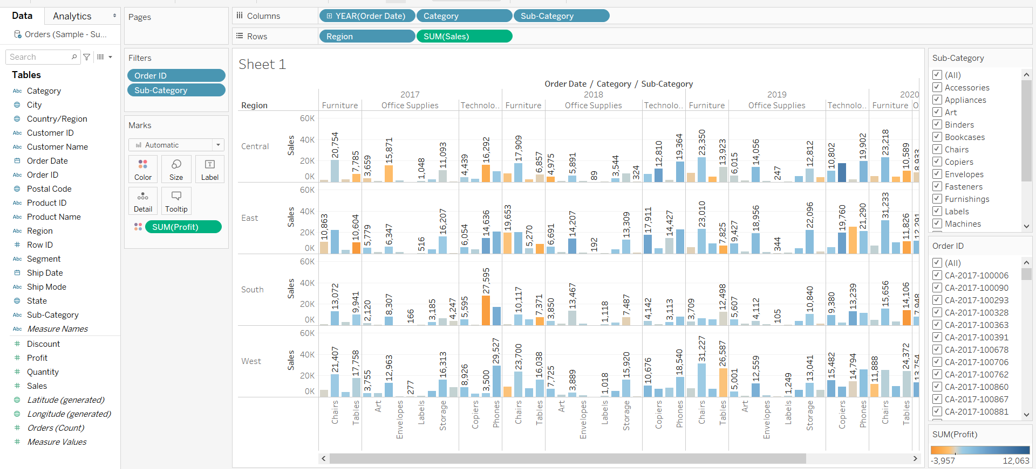
T
break up your view by region:
2.Select All in the Sub-Category filter card to show all sub-categories again.
3.From the Data pane, drag Region to the Rows shelf (Row names) and place it to the left of Sum(Sales).
Tableau creates a view with multiple axes broken down by region.

Slide 29
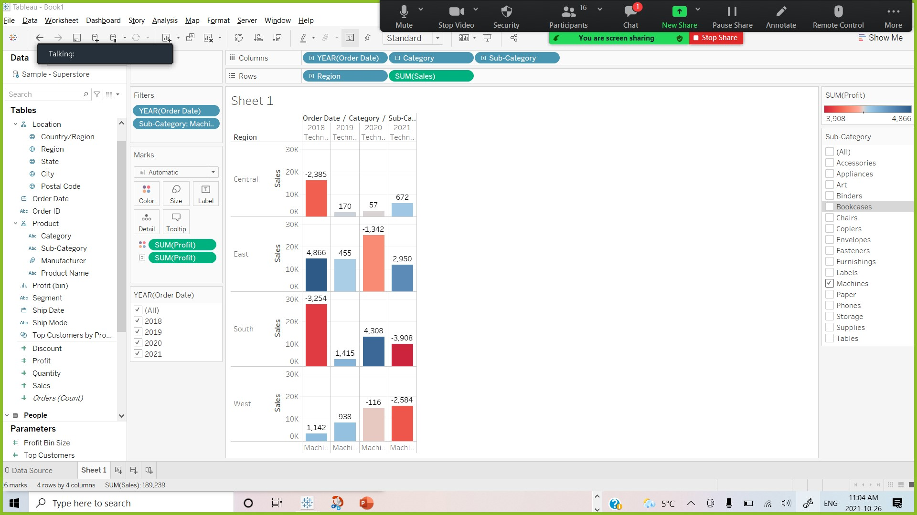
T
Now you see sales and profitability by product for each region. Now you can compare Tables, Bookcases, and Machines in regions. In the view, in the Sub-Category filter card, clear all of the check boxes except Machines. By adding region to the view, you notice that machines in the South are reporting a higher negative profit overall than in your other regions. You've discovered a hidden insight!
If you want to compare them better, you can bring profit to label

Slide 30
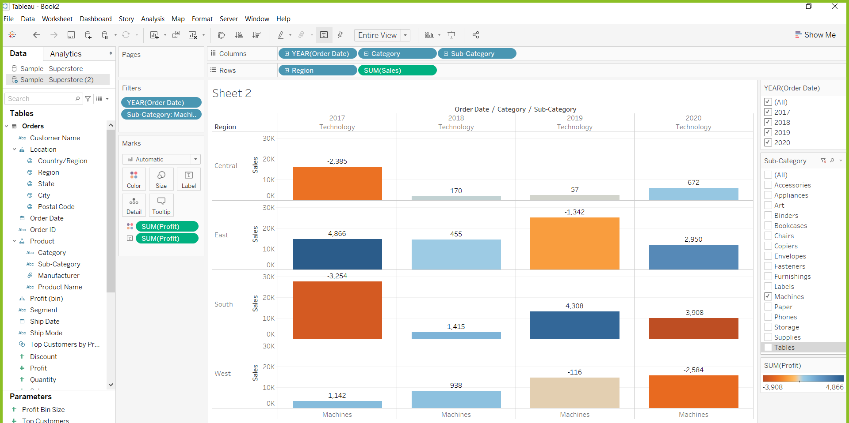

Slide 31
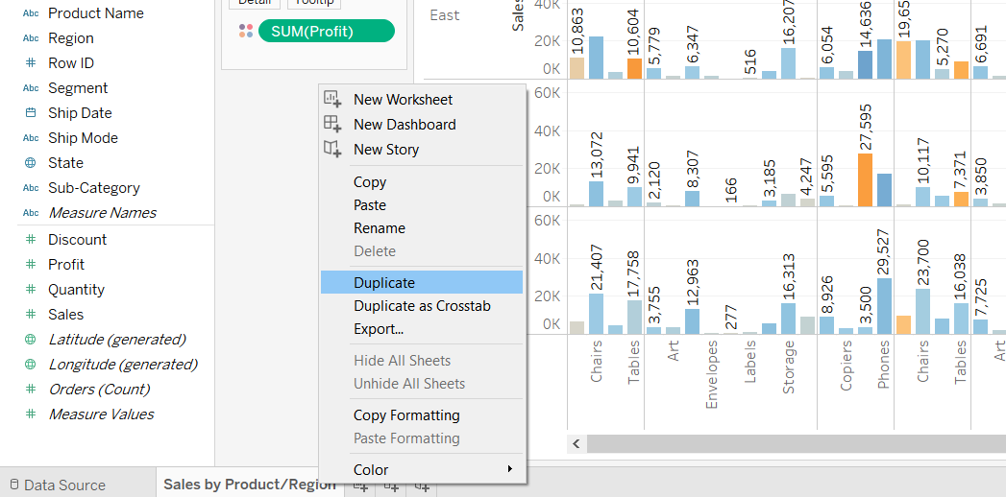
T
Select All in the Sub-Category filter card (if you changed your filter) to show all sub-categories again, name the worksheet and add a title.
At the bottom-left of the workspace, double-click Sheet 1 and type Sales by Product/Region.
You choose to focus your analysis on the South, but you don't want to lose the view you've created. In Tableau Desktop, you can duplicate your worksheet to continue where you left off.
In your workbook, right-click the Sales by Product/Region sheet and select Duplicate.

Slide 32
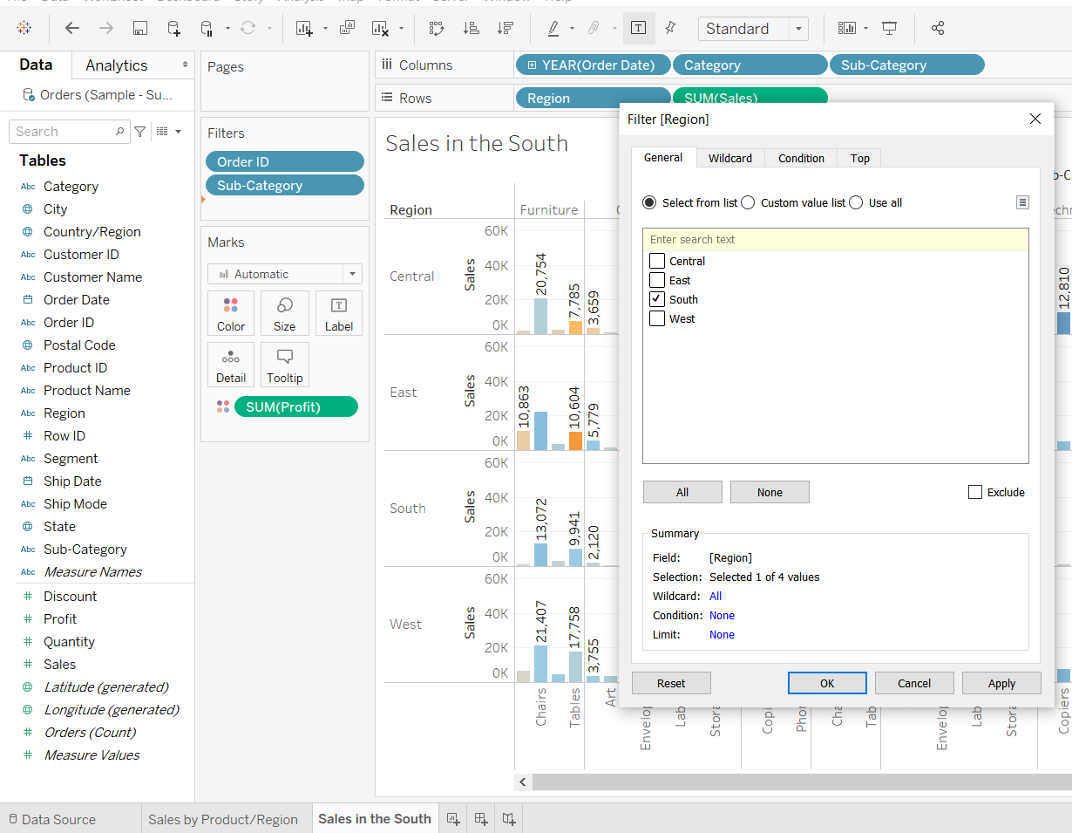
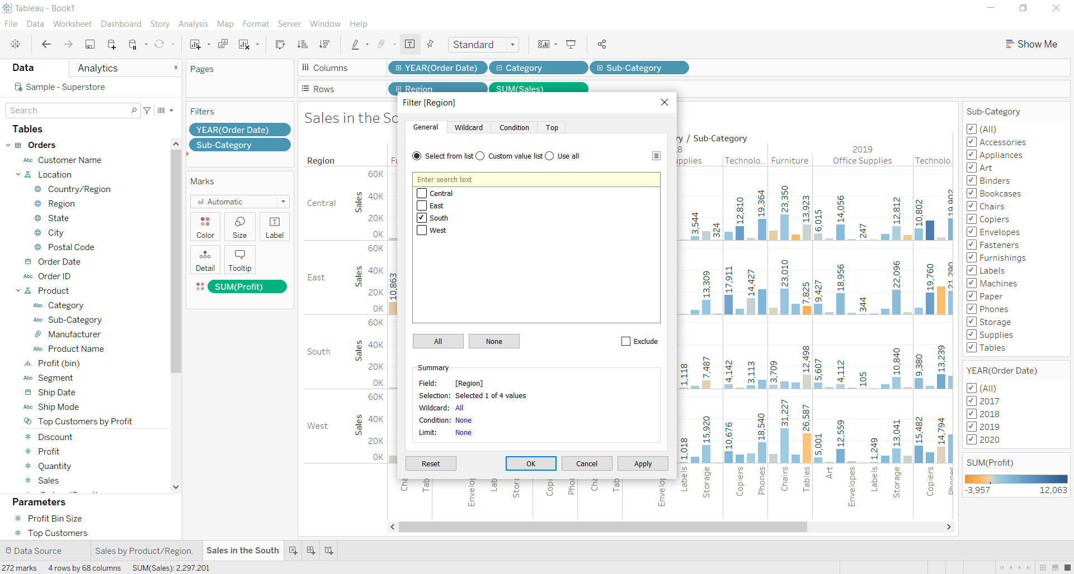
T
Rename the duplicated sheet to Sales in the South.
In your new worksheet, from the Data pane, drag Region to the Filters shelf to add it as a filter in the view.
In the Filter Region dialog box, clear all check boxes except South and then click OK.

Slide 33
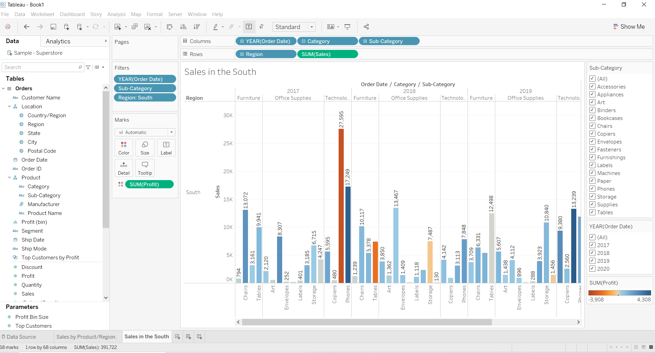
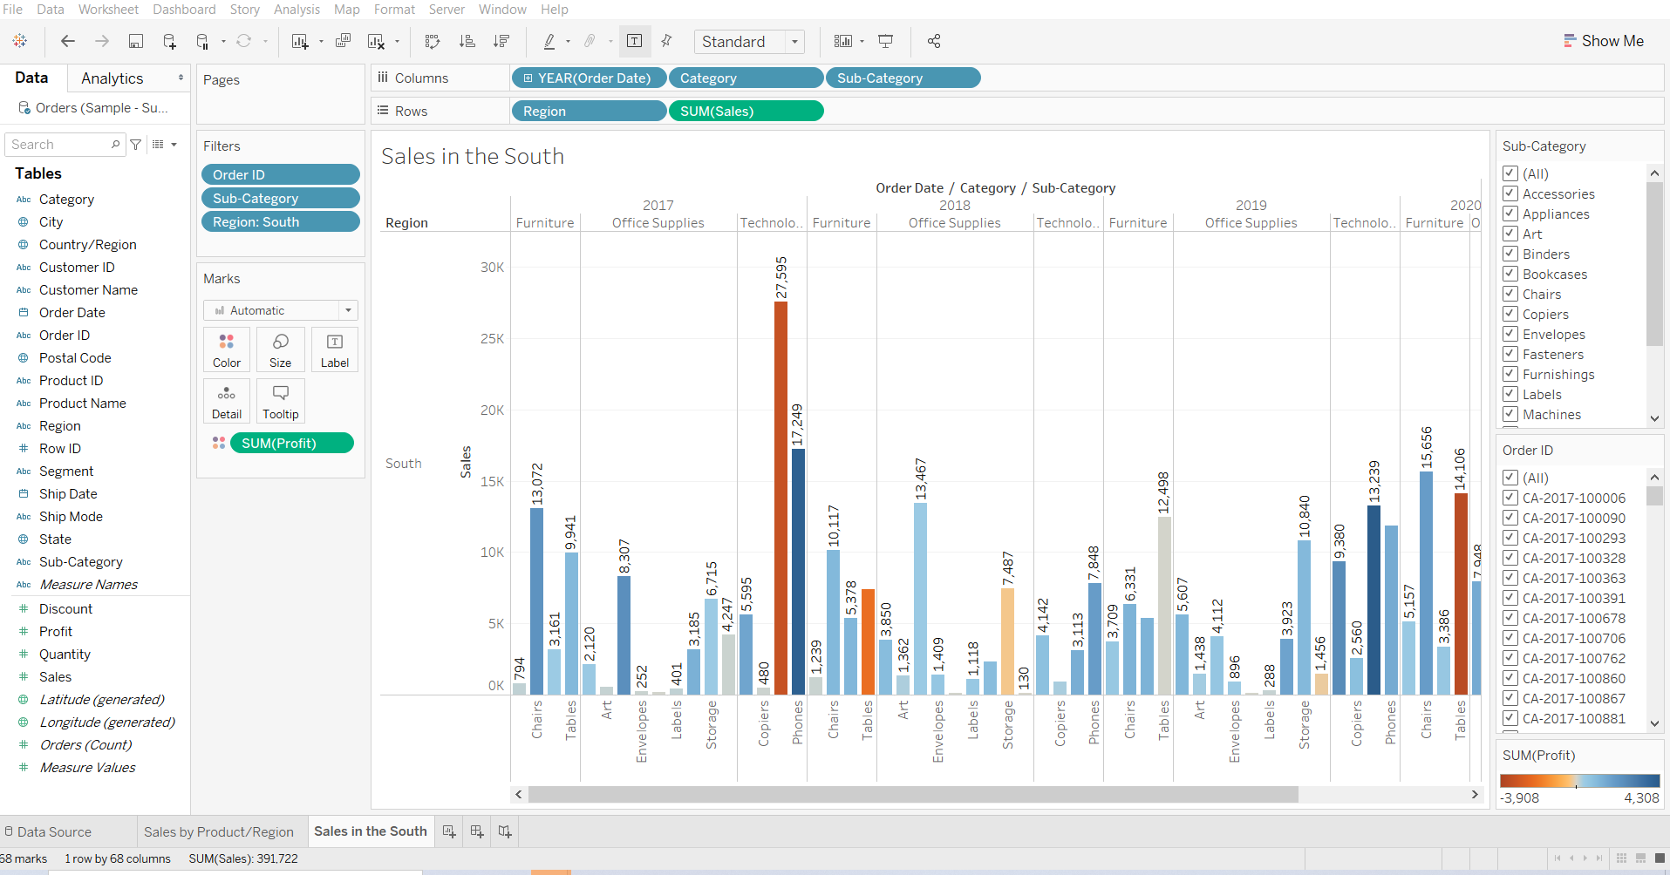
T
Your view updates to look like the image below. Now you can focus on sales and profit in the South. You immediately see that machine sales had negative profit in 2017 and again in 2020. This is definitely something to investigate!

Slide 34
T
Save your work by selecting File > Save As. Give your workbook a name, such as Regional Sales and Profits.
Step summary
In this step you used filter and color to make working with your data a bit easier. You also learned about a few fun features that Tableau offers to help you answer key questions about your data. You learned how to:
Apply filters and color to make it easier to focus on the areas of your data that interest you the most.
Interact with your chart using the tools that Tableau provides.
Duplicate worksheets and save your changes to continue exploring your data in different ways without losing your work.
Having explored your data in Tableau Desktop, you've identified areas of concern. You know sales and profit in the South are a problem, but you don't yet have a solution. You want to look at other factors that might be contributing to these results. Next, you'll leverage another key feature in Tableau to work with geographic data.

Slide 35
Step 4: Explore your data geographically

Slide 36
T
You've built a great view that allows you to review sales and profits by product over several years. And after looking at product sales and profitability in the South, you decide to look for trends or patterns in that region.
Since you're looking at geographic data (the Region field), you have the option to build a map view. Map views are great for displaying and analyzing this kind of information. Plus, they're just plain cool!
For this example, Tableau has already assigned the proper geographic roles to the Country, State, City, and Postal Code fields. That's because it recognized that each of those fields contained geographic data. You can get to work creating your map view right away.
Tableau recognizes a lot of common geographic data, such as state and city names. When Tableau recognizes this type of data, it automatically assigns fields appropriate geographic roles, so they become geographic fields.
Geographic fields have globe icons next to them in the Data pane. If a field is assigned a geographic role, Tableau automatically creates a map view when you add the field to Detail on the Marks card. More on that later.

Slide 37
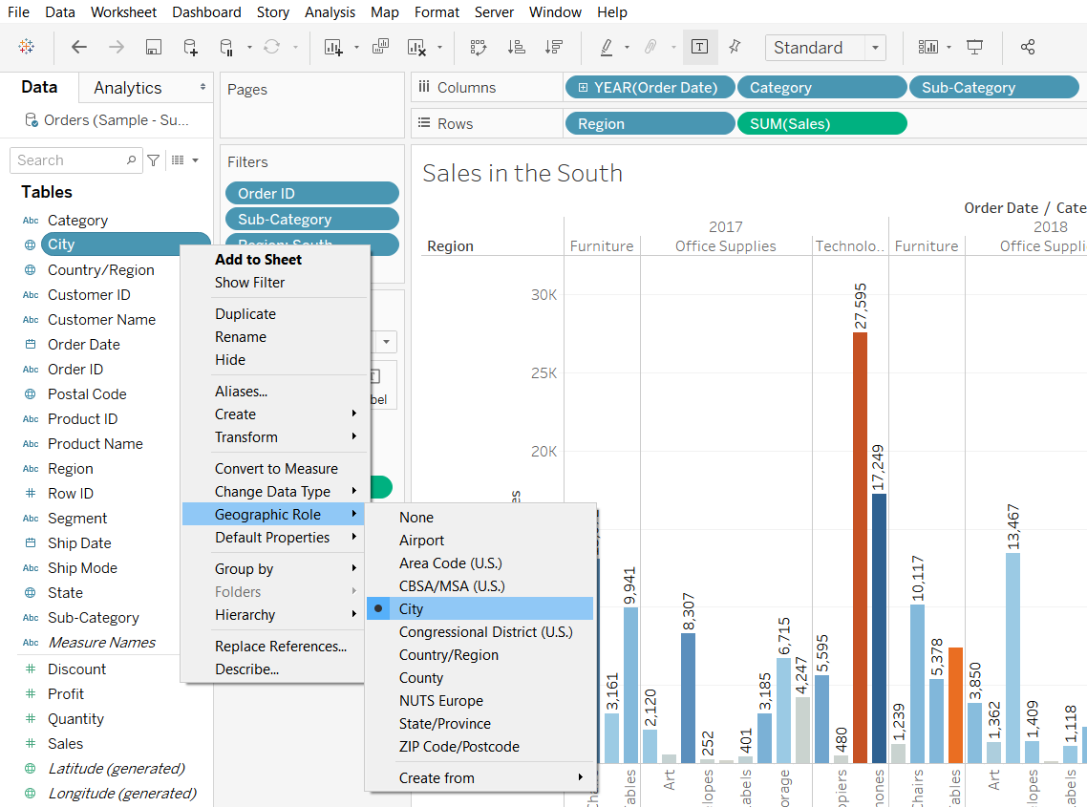
T
If Tableau doesn't recognize your data as geographic, you can manually assign a geographic role to each of the relevant fields.
There are several geographic roles to choose from:
Airport
Area Code
CBSA/MSA
City
Congressional District
Country/Region
County
NUTS Europe
State/Province
Zip Code/Postcode

Slide 38
Build a map view

Slide 39
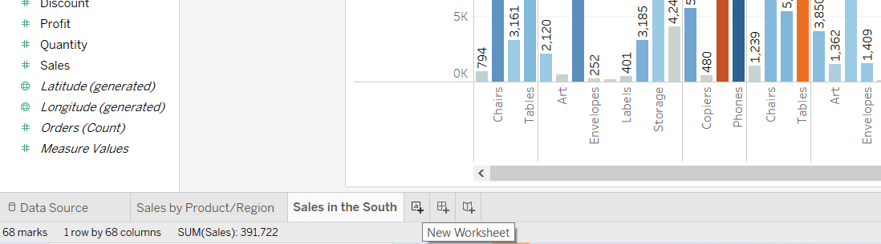
T
Start fresh with a new worksheet.
Click the New worksheet icon at the bottom of the workspace.(If you have sheet 1 as well as sales by Product/region and sales in the south , please delete it by right clicking on its name and select delete)
Tableau keeps your previous worksheet and creates a new one so that you can continue exploring your data without losing your work.

Slide 40
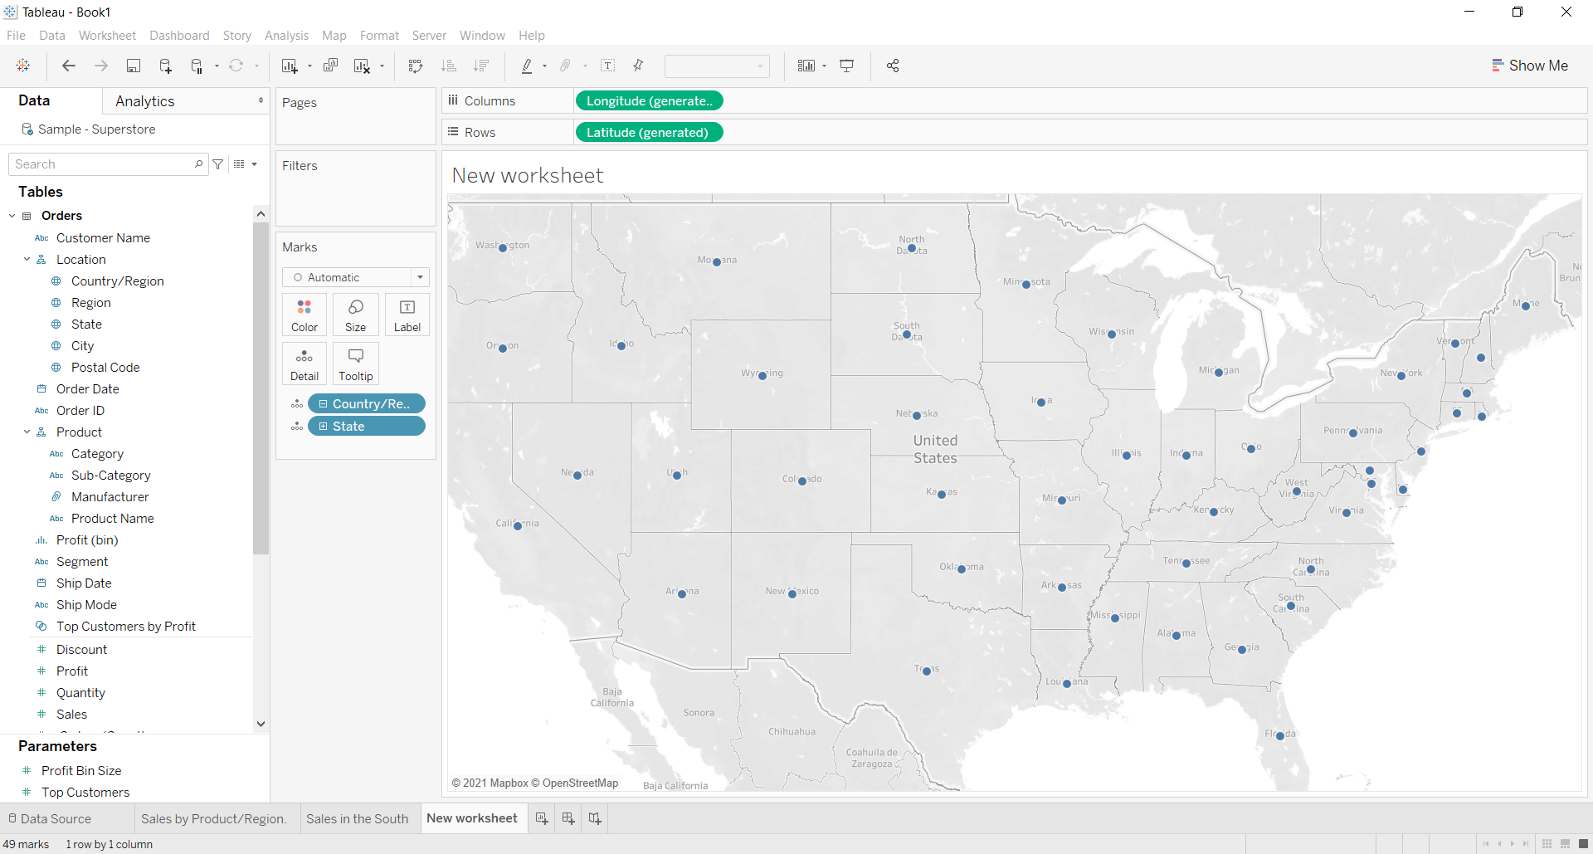
T
In the Data pane, double-click Country/Region and State to add it to Detail on the Marks card.
You’ve got a map view.
Note: You can double-click fields to quickly add them to the view. When you double-click a geographic field specifically, it's automatically added to Detail on the Marks card, and a map view is created with marks for each location listed in the field.

Slide 41
T
There is a mark for each of the 48 contiguous states in your data source. (Sadly, Alaska and Hawaii are not included in your data source, so they are left out.)
Notice that Latitude and Longitude fields are also added to the Columns and Rows shelves. You can think of these as X and Y fields. They're essential any time you want to create a map view, because each location in your data is assigned a latitudinal and longitudinal value. Sometimes the Latitude and Longitude fields are generated by Tableau. Other times, you might have to manually include them in your data.
Now, having a cool map focused on 48 states is one thing, but you wanted to see what was happening in the South, remember?

Slide 42
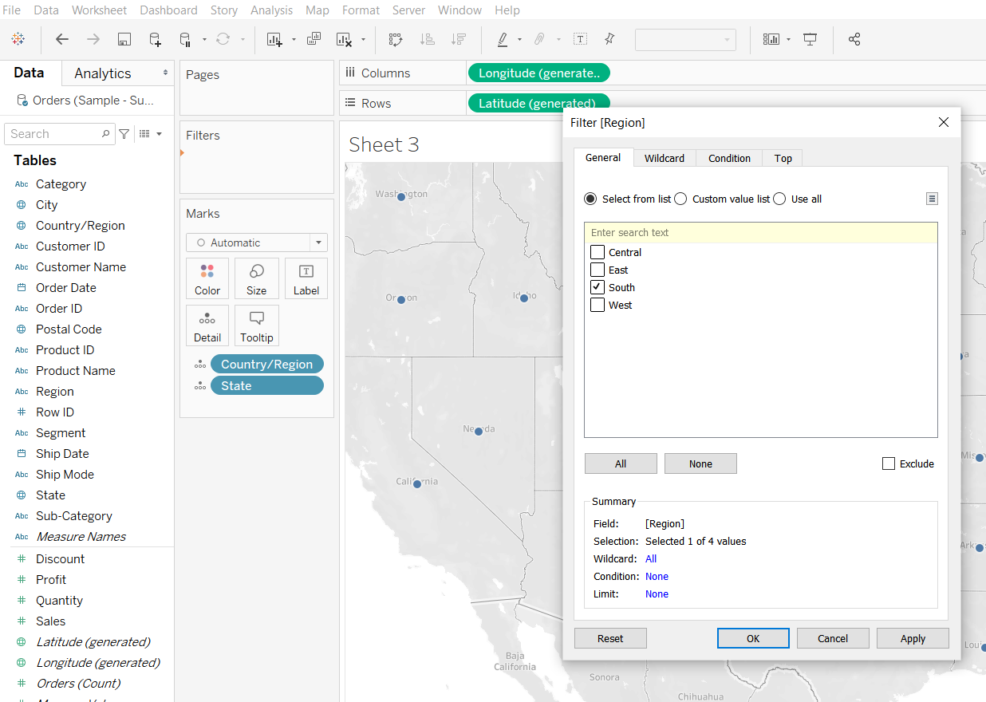
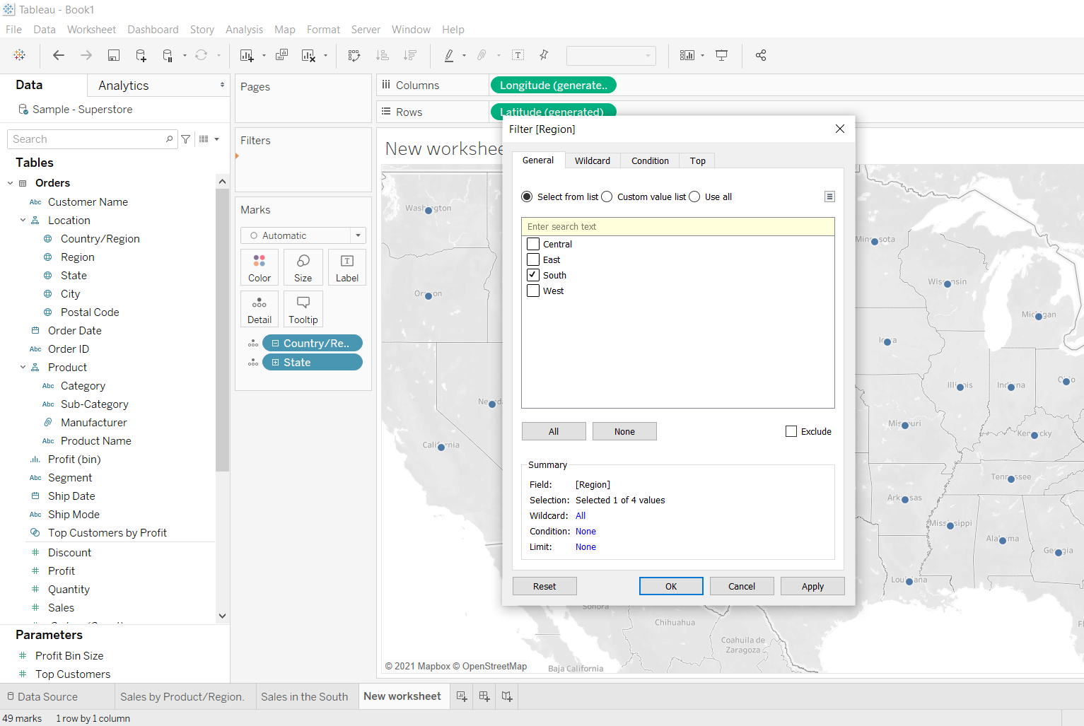
T
Drag Region to the Filters shelf, and then filter down to the South only. The map view zooms in to the South region, and there is a mark for each state (11 total).
Now you want to actually see how your data shapes up for this region, so you start to drag other fields to the Marks card:

Slide 43
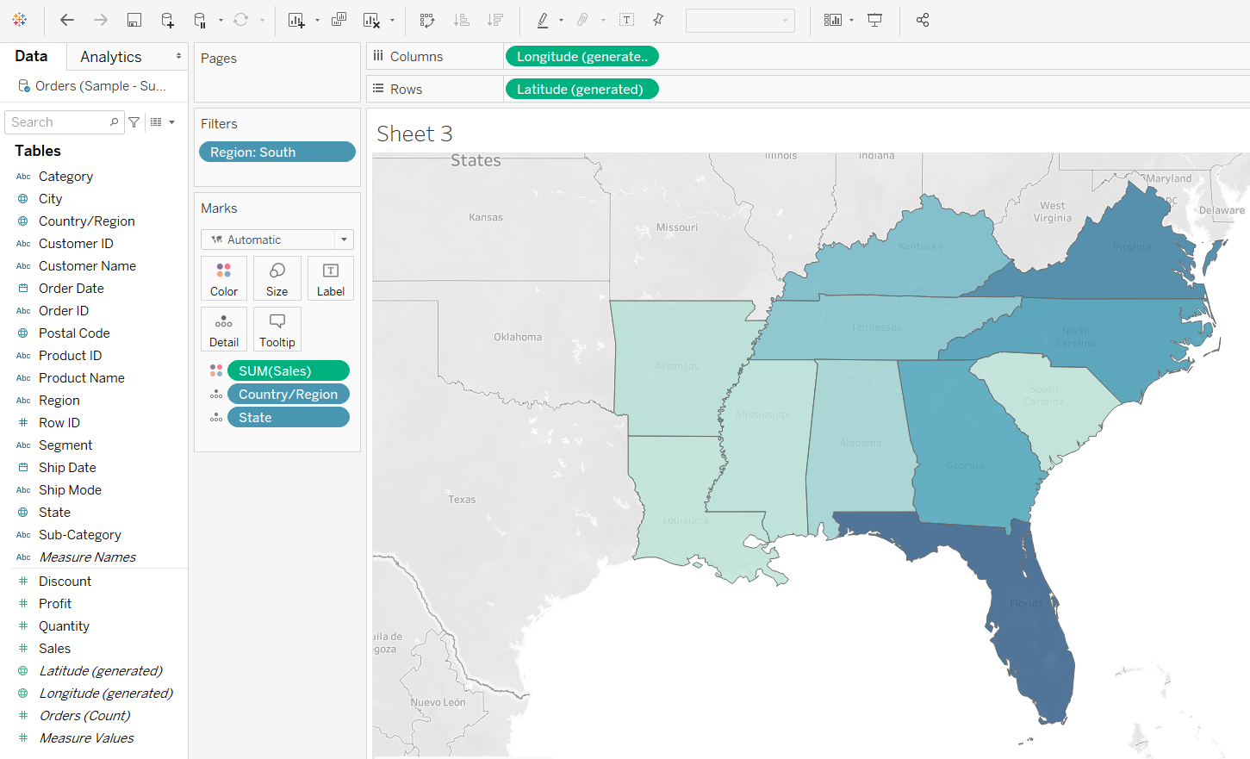
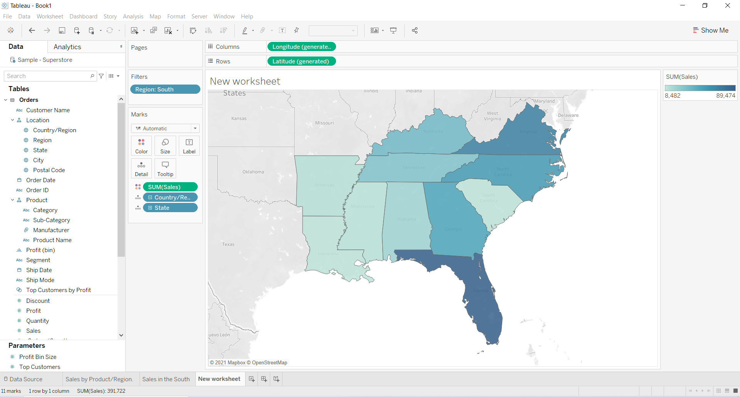
T
4.Drag the Sales measure to Color on the Marks card.

Slide 44
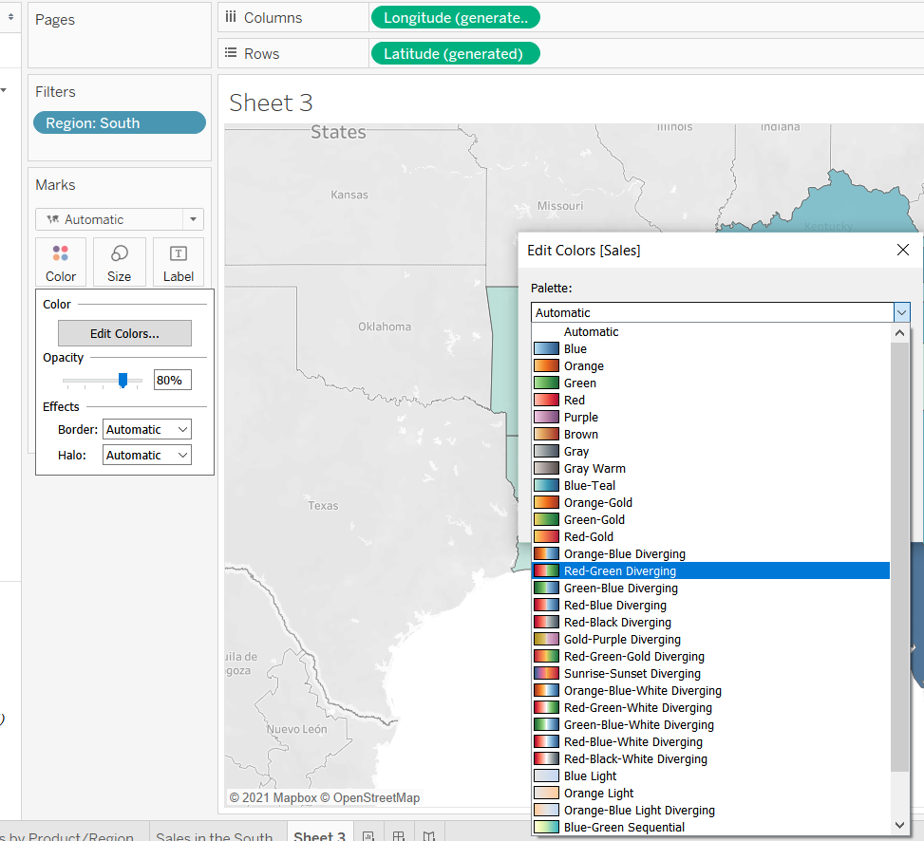
The view automatically updates to a filled map, and colors each state based on its total sales.
Any time you add a continuous measure that contains positive numbers (like Sales) to Color on the Marks card, your filled map is colored blue. Negative values are assigned orange.
Sometimes you might not want your map to be blue. Maybe you prefer green, or your data isn’t something that should be represented with the color blue, like wildfires or traffic jams. That would just be confusing!
No worries, you can change the color palette just like you did before.
Click Color on the Marks card and select Edit Colors.
For this example, you want to see which states are doing well, and which states are doing poorly in sales.
In the Palette drop-down list, select Red-Green Diverging and click OK. This should allow you to quickly see the low performers and the high performers.

Slide 45
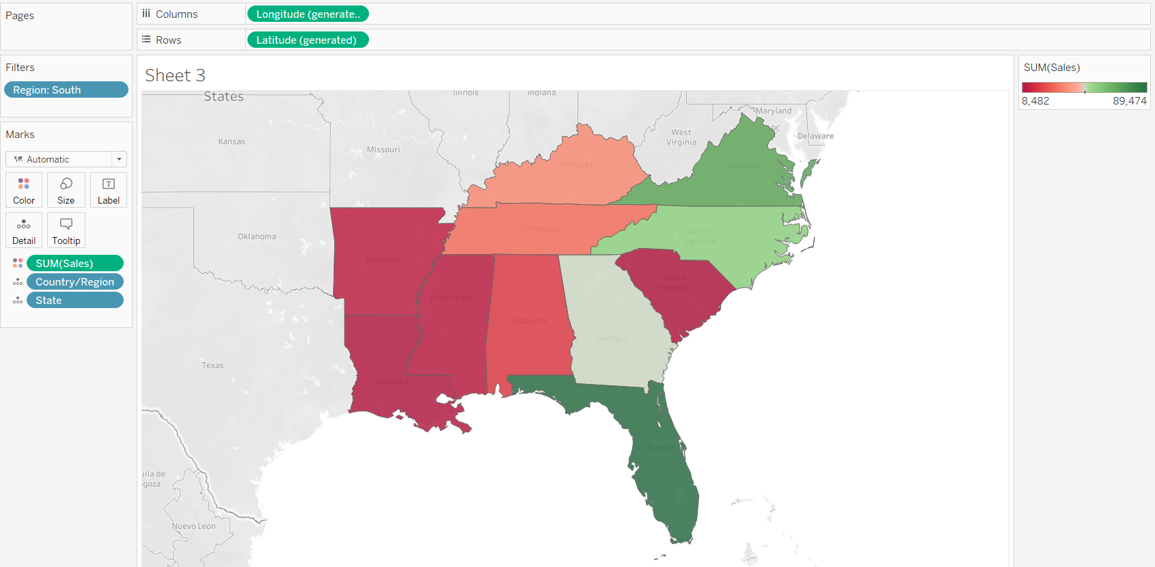
T
But wait. Everything just went red! What happened?
The data is accurate, and technically you can compare low performers with high performers, but is that really the whole story?
Are sales in some of those states really that terrible, or are there just more people in Florida looking to buy your products? Maybe you have smaller or fewer stores in the states that appear red. Or maybe there’s a higher population density in the states that appear green, so there’s just more people to buy your stuff.
Either way, there’s no way you want to show this view to your boss because you aren't confident the data is telling a useful story.
7.Click the Undo icon in the toolbar or press Ctrl+z to return to that nice, blue view.
There’s still a color problem. Everything looks dandy—that’s the problem!
At first glance, it appears that Florida is performing the best. Hovering over its mark reveals a total of 89,474 USD in sales, as compared to South Carolina, for example, which has only 8,482 USD in sales. However, have any of the states in the South been profitable?

Slide 46
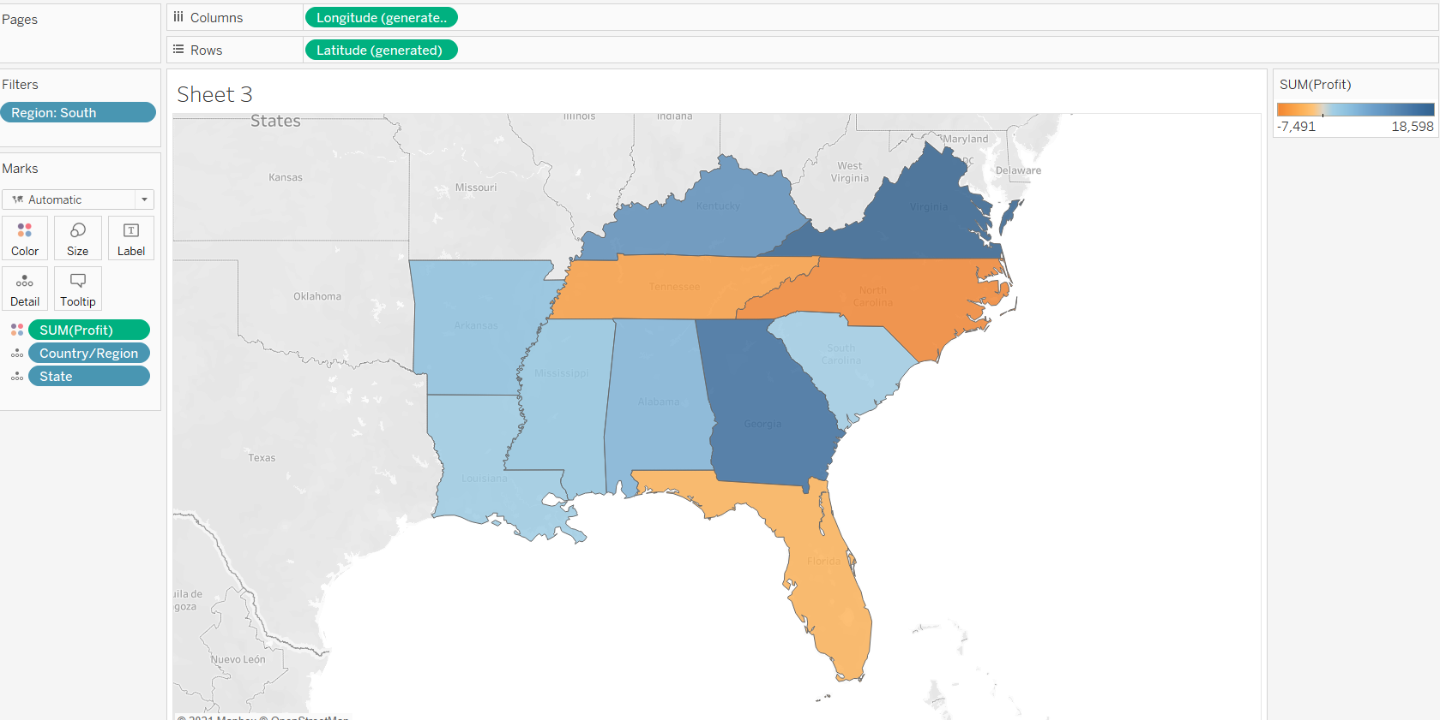
T
8. Drag Profit to Color on the Marks card to see if you can answer this question.
Now that’s more like it! Since profit often consists of both positive and negative values, Tableau automatically selects the Orange-Blue Diverging color palette to quickly show the states with negative profit and the states with positive profit.
It’s now clear that Tennessee, North Carolina, and Florida have negative profit, even though it appeared they were doing okay—even great—in Sales. But why? You'll answer that in the next step.

Slide 47
Step 5: Drill down into the details

Slide 48
What is Tableau Drill Down ?
Tableau Drill Down is the feature to represent the hierarchical data view of the visualization. It helps in-depth analysis of a particular dimension and its dimensions with the details of measures. The drill-down reports are context-specific and are created for specific business requirements. Some of the examples of drill-down reports in Tableau is representing sales data for a country, region, state and city levels. Similarly representing the year, month, the date representation is a common use case for drill-down reports. Tableau provision to view the drill-down feature on the dashboard. Drill down is an important feature in Tableau that adds value to business intelligence(BI).

Slide 49
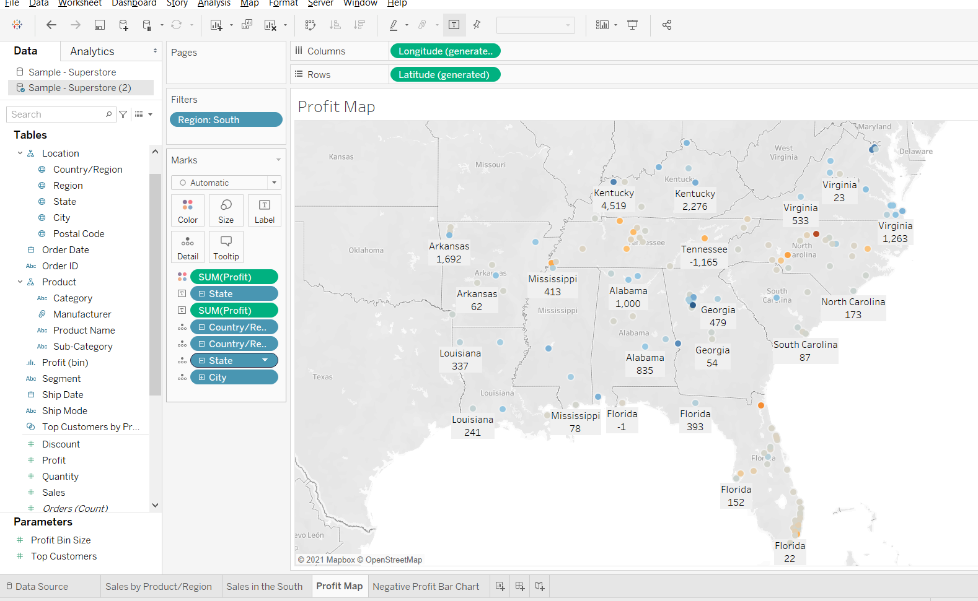
You can Drill Down by clicking on the plus icon as an example on the State field to drill-down to the City level of detail .
Please press Ctrl+z to undo

